Slide 1
Credit Card Approval Prediction Analysis
DATS 6101
WE-R-4(3)
Akshat, Devon, Daqian
April 20, 2022

Slide 2
Introduction
Midterm Term Project: Used cars dataset.
Was very quantitative.
Did not contain the right variables.
Could not help with newer models - Logit, Trees etc.
Final Project: Credit card approval prediction dataset
Available on Kaggle.
Categorical dataset.
Comprises of two files -
Application record -> socio-economic variables pertaining to the applicants
Credit record -> past payment-due behavior of the customers
Approval prediction analysis using logit model , and classification trees.

Slide 3
DataFrame Set-up
Merge two csv files - Performed a simple left join between the two csv’s.
Original data set consists of more than a million rows including NA values in multiple columns.

Slide 4
SMART QUESTION
What factors or variables affect or increase the likelihood of a person being issued a credit card?
Do variables like income category and education level affect a person being issued a credit card?
Does marital status increase the likelihood of being issued a credit card?

Slide 5
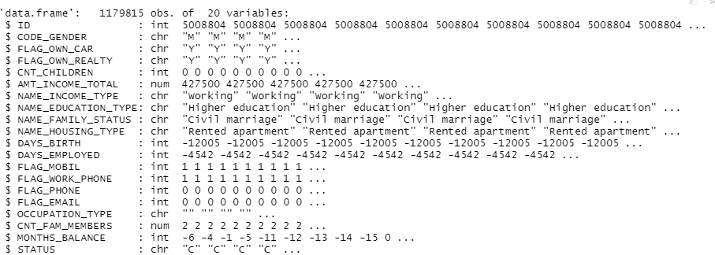
Exploratory Data Analysis
The first dataframe (df) showed 1179815 observations and 20 variables.
Notes:
str(df) – str (original dataframe)

Slide 6
Replacing and removing NAs
We noticed that there are many missing values in the columns “ OCCUPATION_TYPE”, “MONTHS_BALANCE”, and “STATUS” and we decided to delete those NAs.
We also ensured the dataset has no duplicate ID values.
We converted all categorical variables into numeric/ordinal variables for further analysis.
We removed excess variables from the dataset that might not fit our target variable - “status” .
Now, we have the a new data frame - df2 with approximately 25k rows and 14 variables.

Slide 7
Target variable
The target variable 'status' has the following values:
0: 1-29 days past due
1: 30-59 days past due
2: 60-89 days overdue
3: 90-119 days overdue
4: 120-149 days overdue
5: Overdue or bad debts, write-offs for more than 150 days
C: paid off that month
X: No loan for the month
Any Customers that are overdue for more than 60 days are marked as risk or 1 in the target variable. Other customers are marked as no risk or 0.
The target variable “status” has a binary outcome, 1 or 0, predicting if an applicant will be a risk or not.

Slide 8
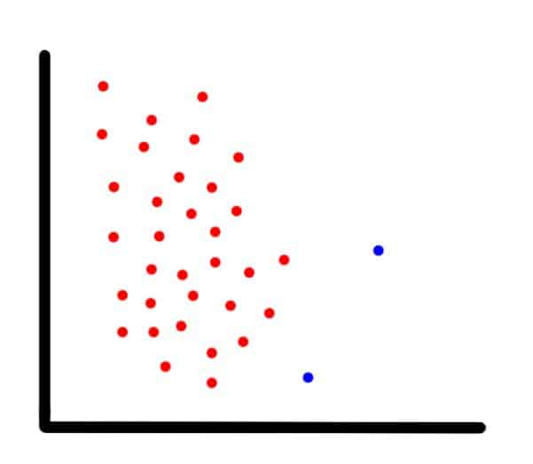
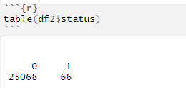
Highly Imbalanced Data Set
We could see that the dataset is highly imbalanced as there are 25068 customers that are ‘non risk’ (0) and just 66 customers that are marked as ‘risk’(1).
Extremely under-represented variable in the target data set.
‘Risk’ or 1 just accounts for 0.23% of the entire data set.
How should we balance this dataset out?

Slide 9
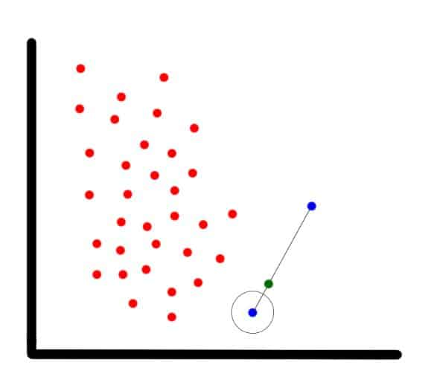
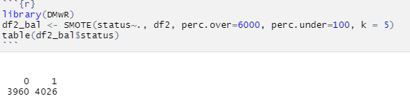
SMOTE
SMOTE stands for Synthetic Minority Oversampling Technique.
A type of oversampling. The usual disadvantage of oversampling is that it creates many duplicate points.
SMOTE is an improved alternative for oversampling. The technique uses KNN or K-nearest neighbors algorithm to generate synthetic or artificial values of the minority or underrepresented target variable in “status”.
Now, the dataset is completely balanced with the target variable, which has 3960 customers marked as '0' or 'non risk' and 4026 customers marked as '1' or 'risk'.

Slide 10
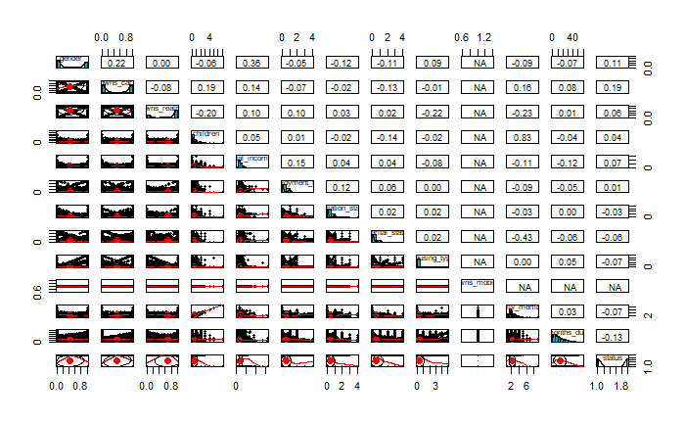
Normality in the balanced set:

Slide 11
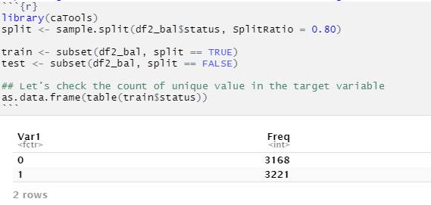
Splitting the balanced model into train/test datasets by using caTools
Notes:
A

Slide 12
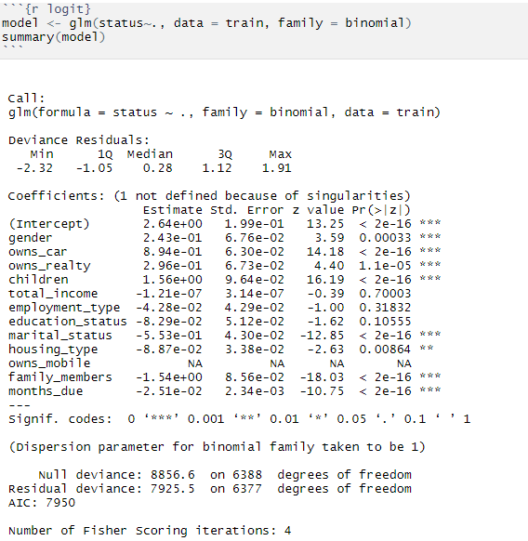
Model 1: Training first Logit model with the with no interaction terms :

Slide 13
Confusion Matrix and Classification Report
Y axis - True values
X axis - Predicted values
Predicted Values
0 1
Actual 0 True Negative TN False Positive FP
Actual 1 False Negative FN True Positive TP
 | FALSE | TRUE
0 | 535 | 257
1 | 243 | 562
Accuracy = 0.678
Precision = 0.679
Recall = 0.683
Accuracy = (TP + TN) / Total
Precision = TP / (TP + FP)
Recall rate = TP / (TP + FN)

Slide 14
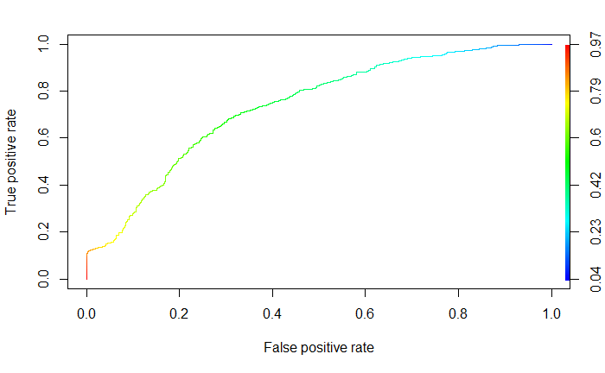
ROC of Logit Model 1:
Area under the curve: 0.737

Slide 15
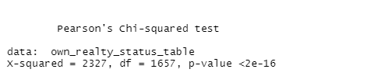
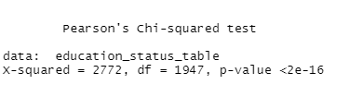
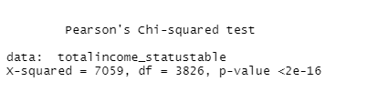

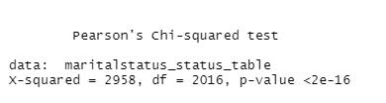
Chi-squared test
We used chi-square method to test several hypotheses.
We tested these five random variables with the target variable “status”. We noticed that their p-values are smaller than 0.05, which rejects null hypothesis. That means the five variables have no effect on status.
Notes:
DD

Slide 16
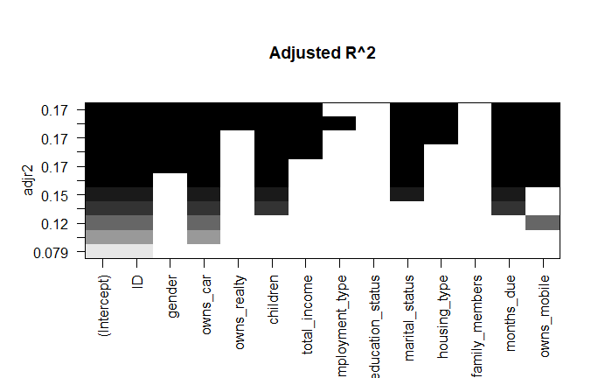
Feature Selection
Performed feature selection on the dataset to select ideal variables that cause a variation in the target variable.
Model selection by using “Exhaustive Search”
Adj R squared values on bic, cp, r squared scale.
Owns_car
Children
Total_income
Marital_status
Months_due
Owns_mobile

Slide 17
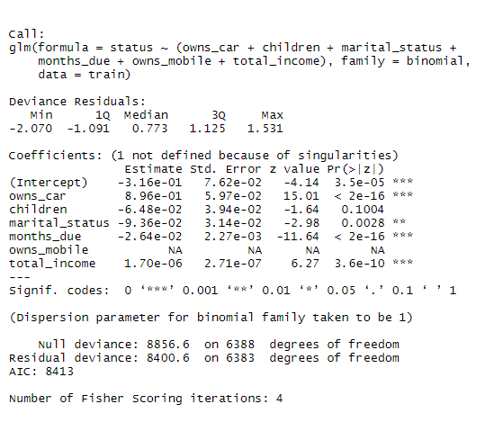
Model 2: Building an updated logit model based on feature selection information
The plots in the previous slide explain that 'owns_car', 'children', 'marital_status', 'months_due', 'owns_mobile' and 'total_income' cause the most variance on the target variable.
We created second logistic model explaining how these selected variables have an effect on the target variable ”status” and compared the new model accuracy with the first model.

Slide 18
Confusion Matrix and Classification Report (Model 2)
Y axis - True values
X axis - Predicted values
Predicted Values
0 1
Actual 0 True Negative TN False Positive FP
Actual 1 False Negative FN True Positive TP
 | FALSE | TRUE
0 | 488 | 304
1 | 328 | 477
Accuracy = 0.604
Precision = .611
Recall = 0.519
Accuracy = (TP + TN) / Total
Precision = TP / (TP + FP)
Recall rate = TP / (TP + FN)

Slide 19
ROC of Logit Model 2:
Area under the curve: 0.625

Slide 20
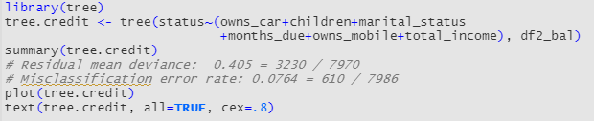
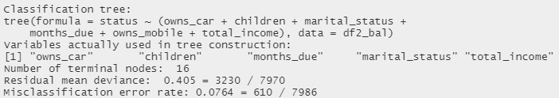
Building a classification tree based on feature selection

Slide 21
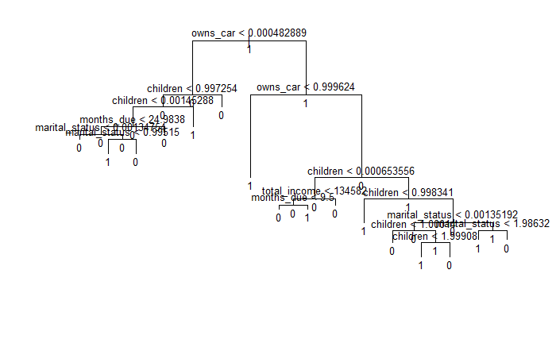
TREE STRUCTURE

Slide 22
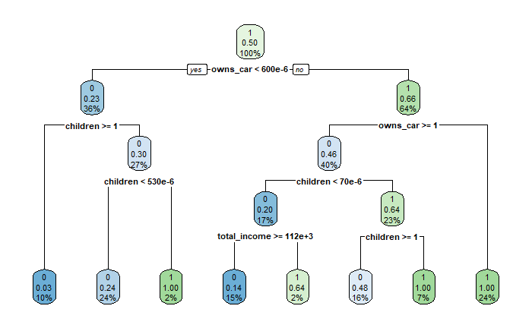

Slide 23

Training the classification tree using train and test sets

Slide 24
Confusion Matrix and Classification Report (classification tree)
Y axis - True values
X axis - Predicted values
Predicted Values
0 1
Actual 0 True Negative TN False Positive FP
Actual 1 False Negative FN True Positive TP
 | FALSE | TRUE
0 | 769 | 110
1 | 23 | 695
Accuracy = 0.917
Precision = 0.863
Recall = 0.968
Accuracy = (TP + TN) / Total
Precision = TP / (TP + FP)
Recall rate = TP / (TP + FN)

Slide 25
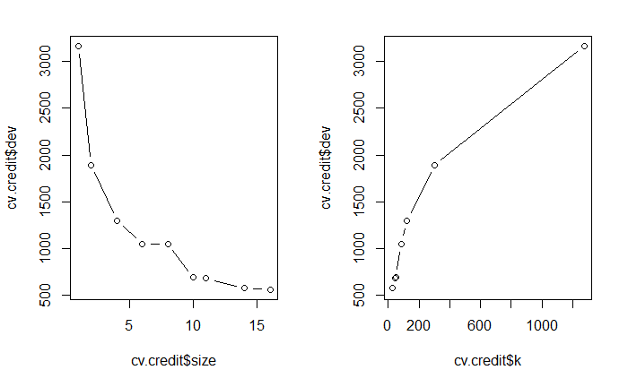
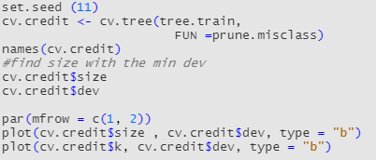
Checking if model could improve by pruning some branches
\
Deviance is strictly decreasing by increasing the size, we cannot prune any branches in this case.

Slide 26
What we found …
Comparison between model 1, model 2 and Classification Tree
From Logistic regressions:
First Logit model with no interaction terms
Classification report showed:
Accuracy = 0.678
Precision = 0.679
Recall = 0.683
Second logit model based on information from feature selection
Classification report showed:
Accuracy = 0.604
Precision = .611
Recall = 0.519
From classification tree:
Classification tree model using train/test sets and pruning
Classification report showed:
Accuracy = 0.91
Precision = 0.863
Recall = 0.968
Classification tree model generated the highest percentage of overall accuracy, precision rate, and recall rate while compared to other two logit models.

Slide 27
Conclusion
Classification Model is the best suited for this category of dataset.
From Logit Models and Feature Selection, it is observed that factors like Previous Months Balance, Marital Status of a Customer, whether they own a Car and a Mobile Phone, and Number of Children might increase the likelihood of that Customer being issued a credit card by a bank!

Slide 28
ANY QUESTIONS?
THANK YOU!

